Slide 1

CAF Hackathon Advanced
Session 5 – Platform Automation and Devops

Slide 2
Platform native Tooling
Notes:
Robert…IaC, GitHUb, AZURE DEVOPS,
BACKLOG – Infra deploy?

Slide 3
Software Development Life Cycle
On-Prem
Plan & Track
Develop
Build & Test
Deploy
Operate
Applications
Data
Runtime
Middleware
Plan
Deploy
O/S
Integration
DevOps Culture
Virtualization
Continuous development
Continuous
Servers
Build
Operate
Storage
Networking

Slide 4
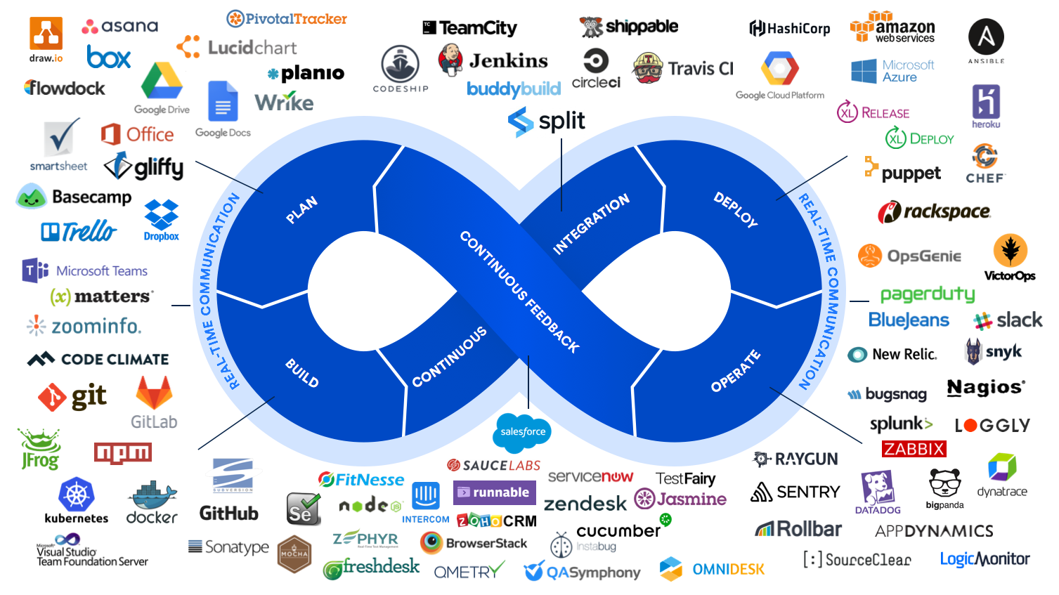

Slide 5
Software Development Life Cycle
On-Prem
Plan & Track
Develop
Build & Test
Deploy
Operate
Applications
Data
Runtime
Middleware
Plan
Deploy
O/S
Integration
DevOps Culture
Virtualization
Continuous development
Continuous
Servers
Build
Operate
Storage
Networking

Slide 6
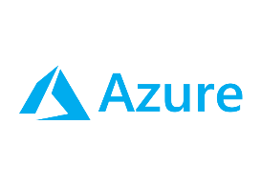
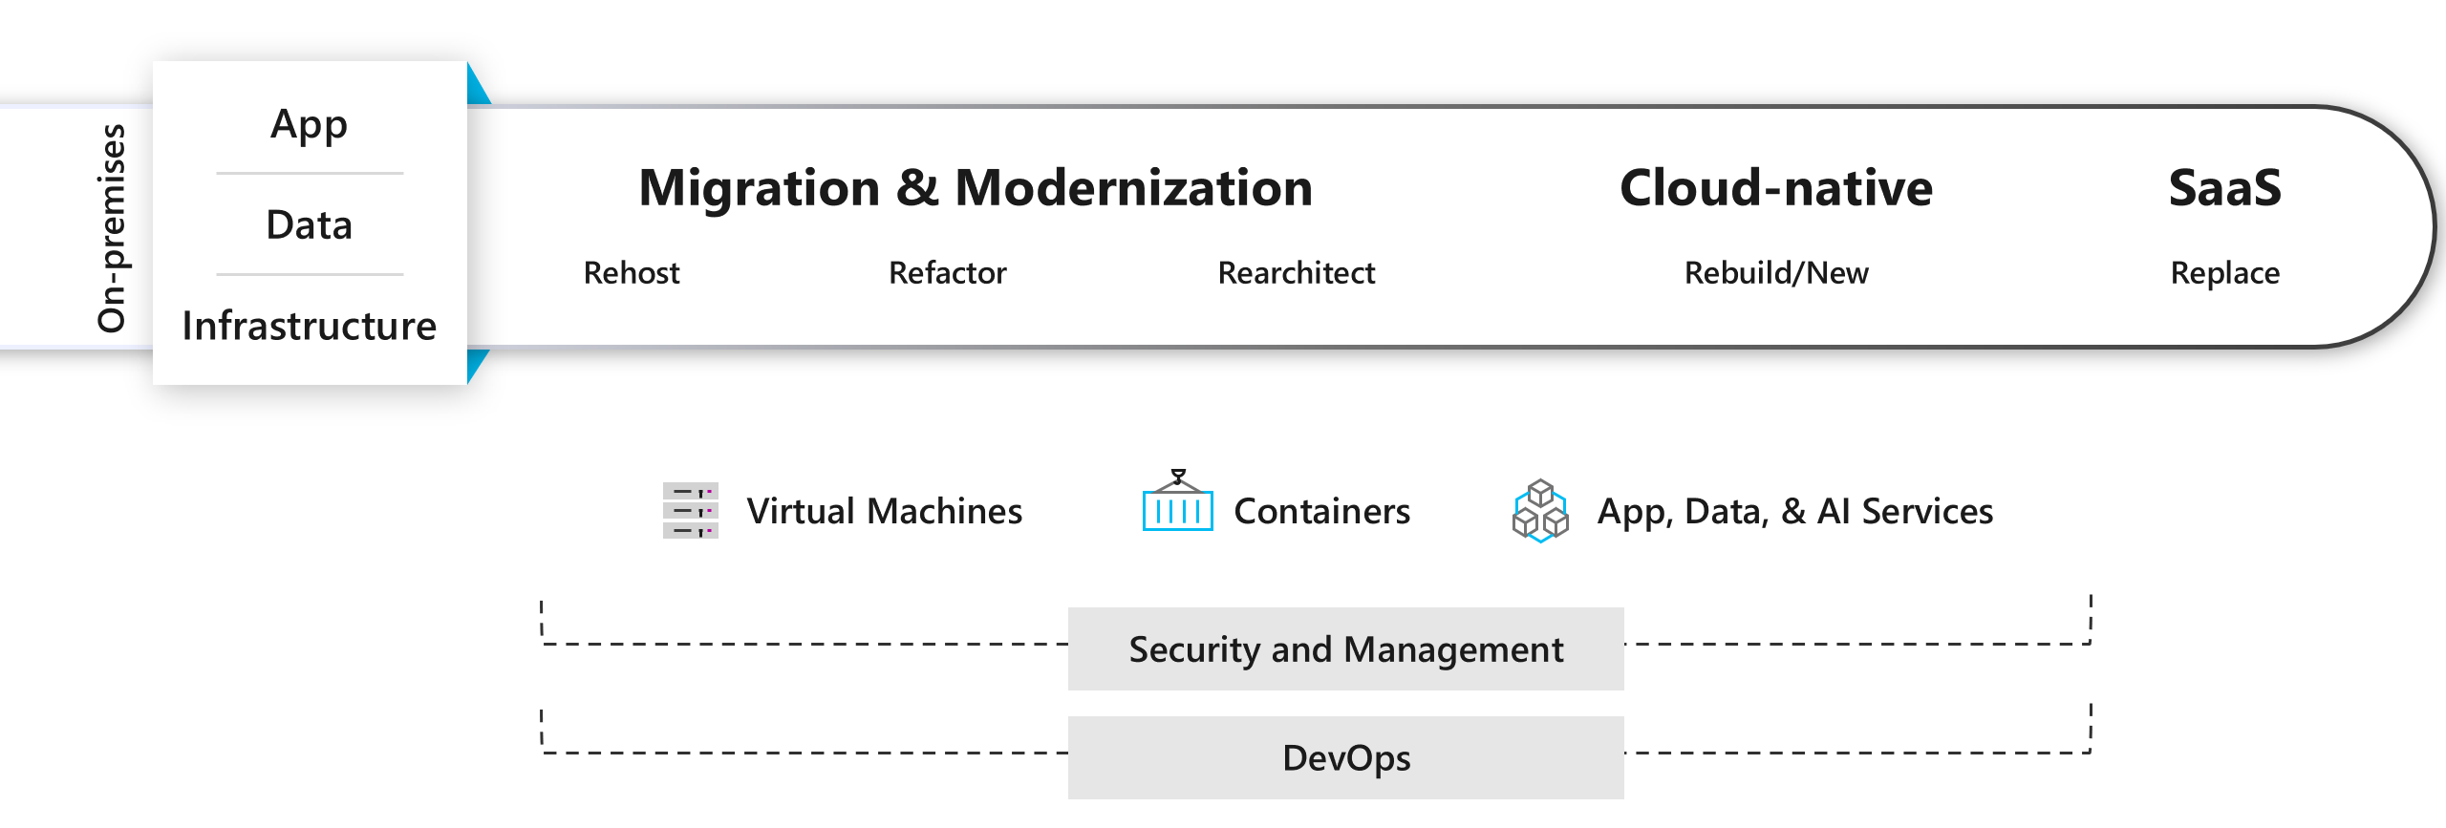
Software Development Life Cycle
On-Prem
PaaS
Plan & Track
Develop
Build & Test
Deploy
Operate
IaaS
Applications
Applications
Applications
Data
Data
Data
Runtime
Runtime
Runtime
Middleware
Middleware
Middleware
O/S
O/S
O/S
Virtualization
Virtualization
Virtualization
Servers
Servers
Servers
Storage
Storage
Storage
Networking
Networking
Networking

Slide 7
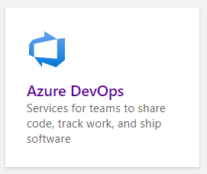
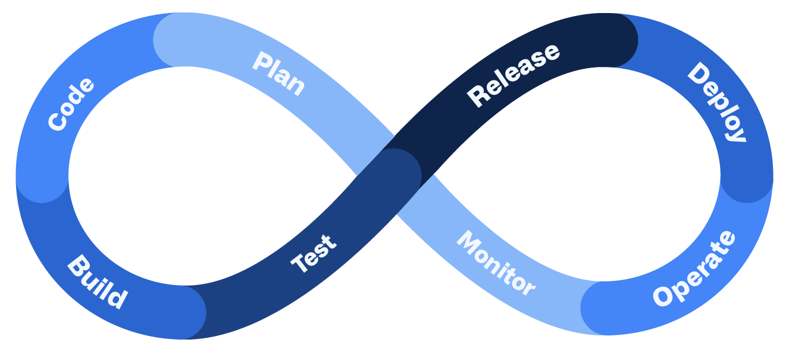
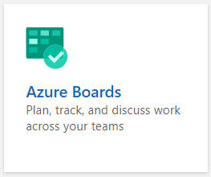
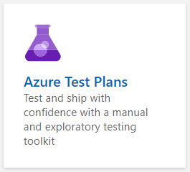
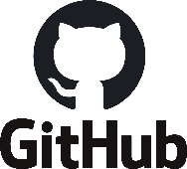
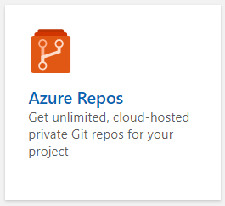
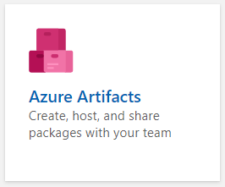
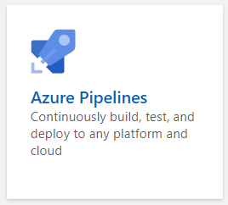
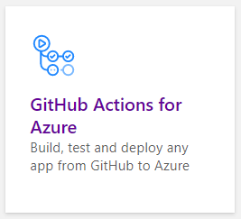

Slide 8
Software Development Life Cycle
On-Prem
PaaS
Plan & Track
Develop
Build & Test
Deploy
Operate
IaaS
Applications
Applications
Applications
Data
Data
Data
Runtime
Runtime
Runtime
Middleware
Middleware
Middleware
O/S
O/S
O/S
Virtualization
Virtualization
Virtualization
Servers
Servers
Servers
Storage
Storage
Storage
Networking
Networking
Networking

Slide 9
+ Landing Zone(s) Development Life Cycle
On-Prem
PaaS
Plan & Track
Develop
Build & Test
Deploy
Operate
IaaS
Applications
Applications
Applications
Data
Data
Data
Runtime
Runtime
Runtime
Middleware
Middleware
Middleware
O/S
Landing Zone(s)
O/S
O/S
Virtualization
Virtualization
Virtualization
Servers
Servers
Servers
Storage
Storage
Storage
Networking
Networking
Networking

Slide 10
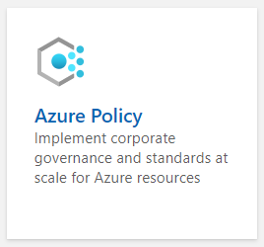
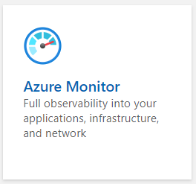
+ Landing Zone(s) Development Life Cycle
On-Prem
PaaS
Plan & Track
Develop
Build & Test
Deploy
Operate
IaaS
Applications
Applications
Applications
Data
Data
Data
Runtime
Runtime
Runtime
Middleware
Middleware
Middleware
O/S
Landing Zone(s)
O/S
O/S
Virtualization
Virtualization
Virtualization
Servers
Servers
Servers
Storage
Storage
Storage
Networking
Networking
Networking

Slide 11
Planning for a DevOps approach
Notes:
Niels

Slide 12
Organization development CAF
https://docs.microsoft.com/azure/cloud-adoption-framework/organize/

Slide 13
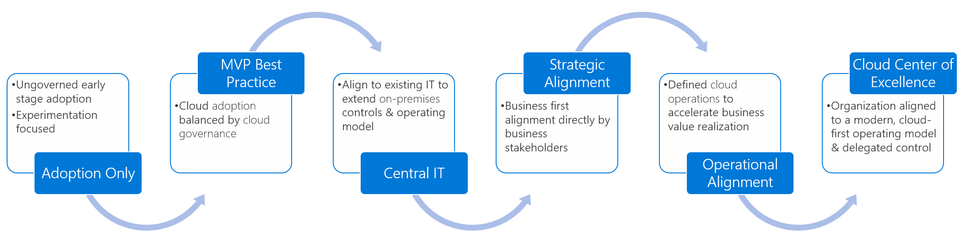
The overall process…

Slide 14
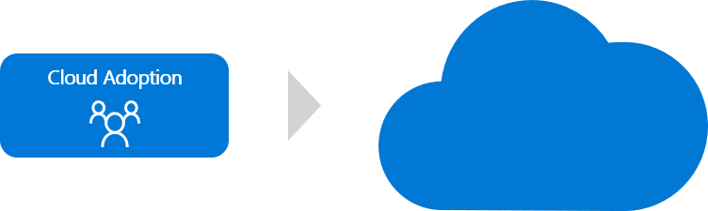
Cloud adoption team only
Notes:
Cloud adoption: Deliver technical solutions.

Slide 15
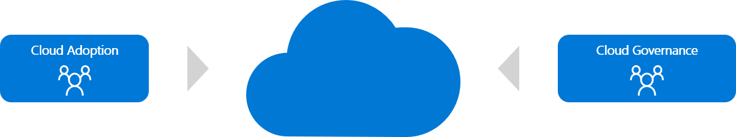
Best practice: MVP - Achieve balance
Notes:
Cloud adoption: Deliver technical solutions.
Cloud governance: Manage risk.
IT governance
Enterprise architecture
Security
IT operations
IT infrastructure
Networking
Identity
Virtualization
Business continuity and disaster recovery
Application owners within IT
Finance owners
Min. scope
Understand business risks introduced by the plan.
Represent the business's tolerance for risk.
Help create a governance MVP.

Slide 16
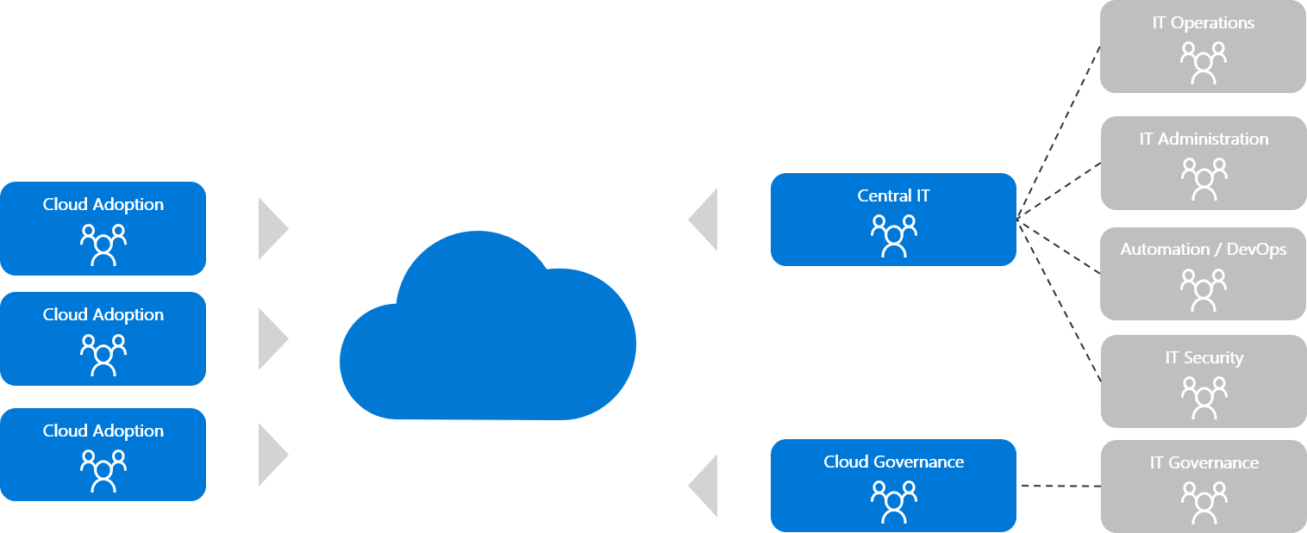
Next potential steps Central IT…
Notes:
Cloud adoption: Deliver technical solutions.
Cloud governance: Manage risk.
Central IT team: Support from existing IT staff.
Vorsicht Obwohl dies ein gemeinsamer Reifeschritt ist, kann er ein hohes Risiko für die Annahme darstellen und möglicherweise Innovationen und Migrationsbemühungen blockieren, wenn sie nicht effektiv verwaltet werden. Im Abschnitt "Risiko" unten erfahren Sie, wie Sie das Risiko einer Zentralisierung zu einem kulturellen Antimuster mindern können.
The skills needed to provide centralized IT functions could be provided by:
An existing central IT team
Enterprise architects
IT operations
IT governance
IT infrastructure
Networking
Identity
Virtualization
Business continuity and disaster recovery
Application owners within IT

Slide 17
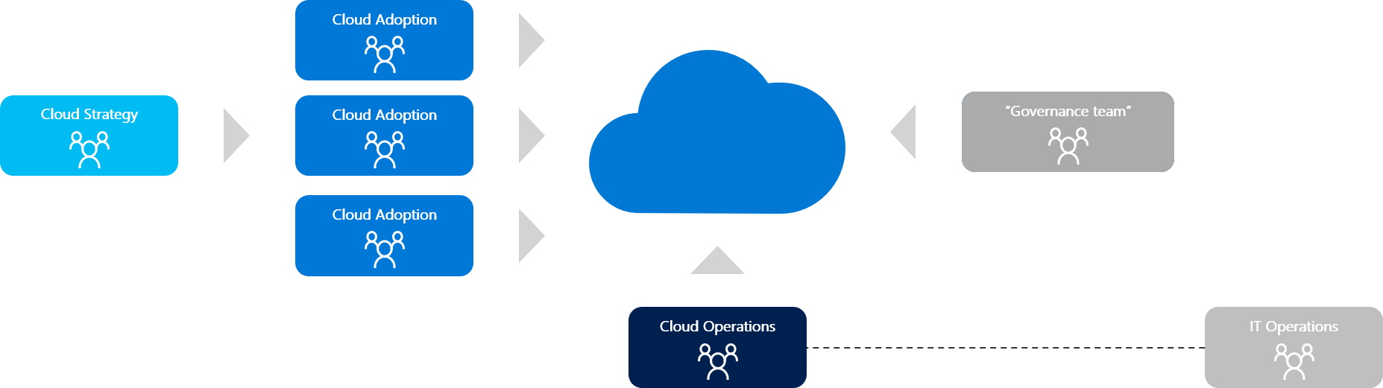
Strategic and operational alignment
Notes:
Cloud strategy: Align technical change to business needs. Finance
Line of business
Human resources
Operations
Enterprise architecture
IT infrastructure
Application groups
Project managers (often with agile project management experience)
Cloud operations: Support and operate adopted solutions.
The skills needed to provide cloud operations functions can be provided by:
IT operations
Outsource IT operations vendors
Cloud service providers
Cloud-managed service providers
Application-specific operations teams
Business application operations teams
DevOps teams
IaC, Pipelines…
Cloud adoption: Deliver technical solutions.
Cloud governance: Manage risk.
Central IT team: Support from existing IT staff.
https://docs.microsoft.com/en-us/azure/cloud-adoption-framework/organize/cloud-strategy

Slide 18
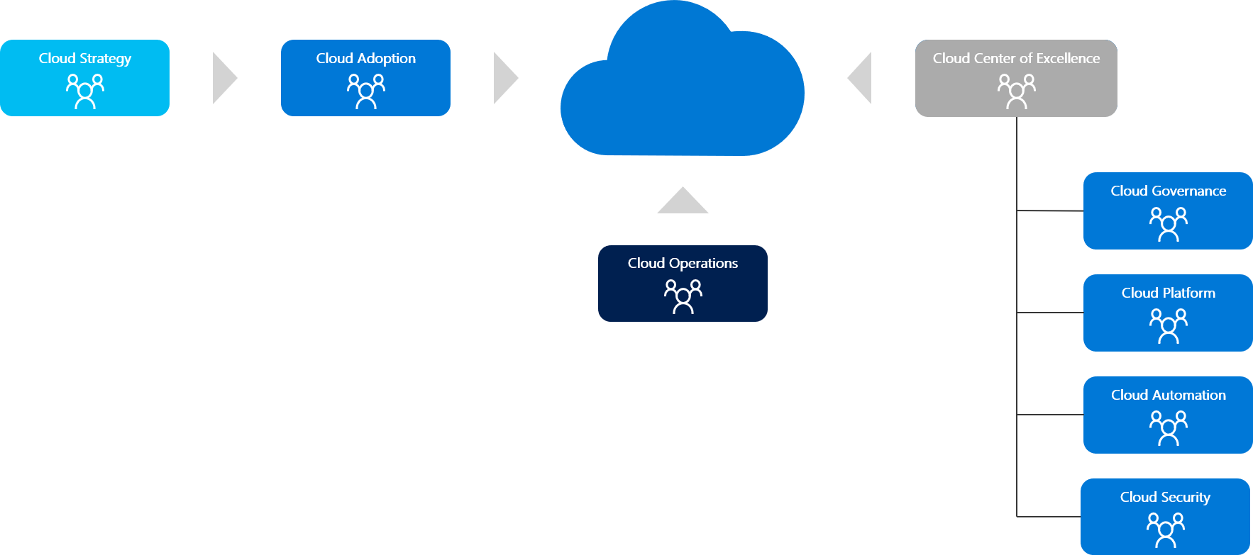
Cloud center of excellence
Notes:
Cloud strategy: Align technical change to business needs.
Cloud adoption: Deliver technical solutions.
Cloud governance: Manage risk.
Cloud operations: Support and operate adopted solutions.
Cloud platform: Operate and mature the platform.
Cloud automation: Accelerate adoption and innovation.
Cloud security: Manage information security risk.
Cloud center of excellence: Improve quality, speed, and resiliency of adoption.
Ziel des CCoE ist es, Helfen Sie beim Aufbau einer modernen IT-Organisation durch agile Ansätze zur Erfassung und Implementierung von Geschäftsanforderungen. Verwenden Sie wiederverwendbare Bereitstellungspakete, die mit Sicherheits-, Compliance- und Dienstverwaltungsrichtlinien übereinstimmen. Verwalten Sie eine funktionsfähige Azure-Plattform in Übereinstimmung mit den betrieblichen Verfahren. Überprüfen und genehmigen Sie die Verwendung von Cloud-nativen Tools. Standardisieren und automatisieren Sie im Laufe der Zeit häufig benötigte Plattformkomponenten und -lösungen.

Slide 19
And what are considerations in a DevOps approach?

Slide 20

Planning for a DevOps approach
Where central teams are concerned, you should use pipelines for continuous integration and continuous deployment. Use the pipelines to manage policy definitions, role definitions, policy assignments, management group hierarchies, and subscriptions. These pipelines help ensure that you can operationally manage multiple subscriptions while still conforming to a desired state.
The blanket application of a DevOps model won't instantly establish capable DevOps teams.
Investing in engineering capabilities and resources is critical.

Slide 21
Planning for a DevOps approach
You can arrange internal and external DevOps roles and functions from a variety of sources that align with your organization's strategy.
For some legacy applications, the associated application team might not have engineering resources required to align with a DevOps strategy.

Slide 22
Design recommendations Planning for a DevOps approach
Establish a cross-functional DevOps platform team to build, manage, and maintain your enterprise-scale architecture. This team should include members from your central IT team, security, compliance, and business units to ensure that a wide spectrum of your enterprise is represented. The following list presents a recommended set of DevOps roles for a central platform team:
PlatformOps (platform operations)
SecOps (security operations)
NetOps (network operations)
AppDevOps

Slide 23
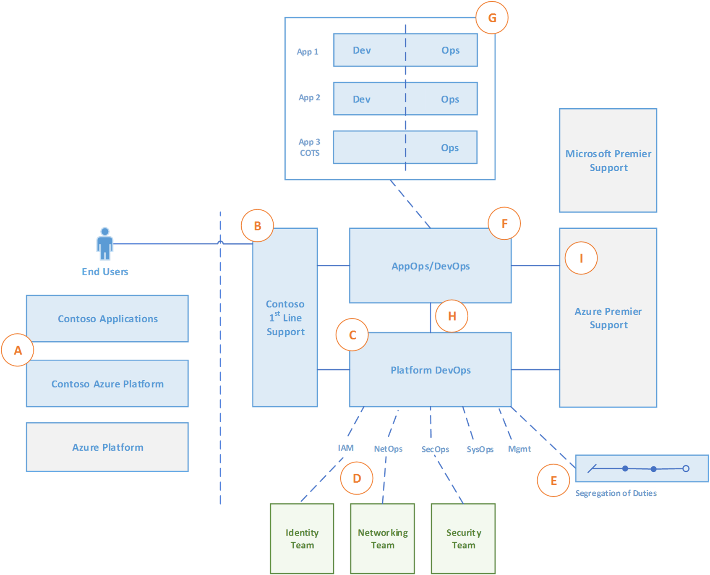
Design recommendations Planning for a DevOps approach

Slide 24
PlatformOps (platform operations)
Subscription provisioning and delegation of required network, identity and access management, and policies.
Platform management and monitoring (holistic).
Cost management (holistic).
Platform-as-code (managing templates, scripts, and other assets).
Responsible for overall operations on Microsoft Azure within the Azure Active Directory tenant (managing service principals, Graph API registration, and defining roles).

Slide 25
SecOps (security operations)
Azure role-based access control (Azure RBAC) (holistic).
Key management (for central services, simple mail-transfer protocol, and domain controller).
Policy management and enforcement (holistic).
Security monitoring and audit (holistic).

Slide 26
SecOps (security operations) NetOps (network operations)
SecOps (security operations)
Azure role-based access control (Azure RBAC) (holistic).
Key management (for central services, simple mail-transfer protocol, and domain controller).
Policy management and enforcement (holistic).
Security monitoring and audit (holistic).
NetOps (network operations)
Network management (holistic).

Slide 27
AppDevOps
Application migration or transformation.
Application management and monitoring.
Azure RBAC (application resources).
Security monitoring and audit (application resources).
Cost management (application resources).
Network management (application resources).
In some instances, you might want to break AppDevOps into more granular roles such as AppDataOps for database management or AppSecOps for more security-sensitive applications.
Provide a central application DevOps function to support applications that don't have existing DevOps capabilities or a business case to establish one (for example, legacy applications with minimal development capabilities).

Slide 28
AppDevOps
Use a policy-driven approach with clear Azure RBAC boundaries to centrally enforce consistency and security across application teams. This ensures a least privilege approach is taken by using a combination of Azure RBAC and Azure Policy, and that workloads are compliant with Azure Policy assignments at all times.
To accelerate Azure adoption, the central platform team should establish a common set of templates and libraries for application teams to draw upon. For example, horizontal (cross-function) guidance can help to support migrations through subject matter expertise and to ensure alignment with the overall target enterprise-scale architecture.

Slide 29
AppDevOps
Don't restrict application teams to use central artifacts or approaches because it hinders their agility. You can enforce consistent baseline configurations through a policy-driven infrastructure approach and Azure RBAC. This ensures that application (business unit) teams are flexible enough to innovate while still able to draw from a predefined set of templates.
Don't force application teams to use a central process or provisioning pipeline for the instantiation or management of application resources. Existing teams that already rely on a DevOps pipeline for application delivery should still be able to use the same tools they have been using. Remember that you can still use Azure Policy to maintain guardrails, independent of how resources are deployed in Azure.

Slide 30
Define central and federated responsibilities

Slide 31
Define central and federated responsibilities
Central teams strive to maintain full control while application owners seek to maximize agility. The balance between these goals can greatly influence the success of the migration.

Slide 32
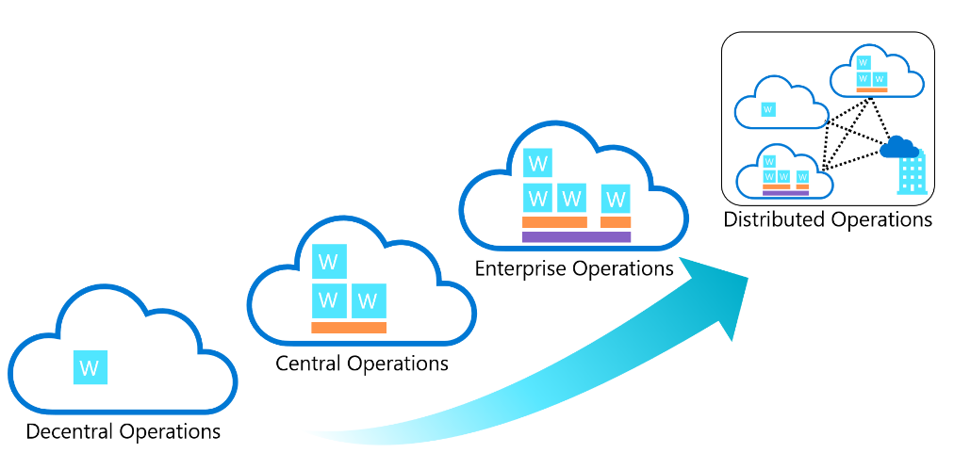
Compare common cloud operating models
Complexity

Slide 33
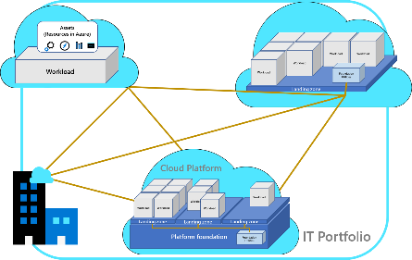
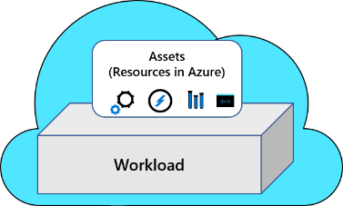
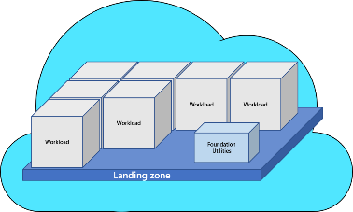
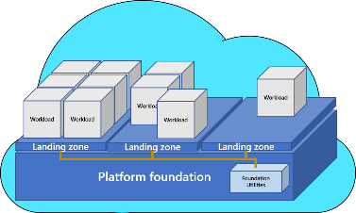
Compare…
Preferred cloud operating model
Decentralized operations
Distributed operations
Centralized operations
Enterprise operations
 | Decentralized ops | Centralized ops | Enterprise ops | Distributed ops
Starting point | Azure Well-Architected Framework (WAF) | Azure landing zones: start-small options | Azure landing zones: CAF enterprise-scale | Business alignment
Iterations | A focus on workloads allows the team to iterate within WAF. | The start-small option requires additional iteration on each methodology, but that can be done as cloud adoption efforts mature. | As illustrated by the reference implementations, future iterations typically focus on minor configuration additions. | Review the Azure landing zone implementation options to start with the option that best meets your operations baseline. Follow the iteration path defined in that option's design principles.

Slide 34
Priorities or scope
A cloud operating model is primarily driven by two factors:
Strategic priorities and motivations.
The scope of the portfolio to be managed.
 | Decentralized operations (ops) | Centralized operations (ops) | Enterprise operations (ops) | Distributed operations (ops)
Strategic priority | Innovation | Control | Democratization | Integration
Portfolio scope | Workload | Landing zone | Cloud platform | Full portfolio
Workload environment | High complexity | Low complexity | Medium complexity | Medium or variable complexity
Landing zone | N/A | High complexity | Medium to low complexity | Low complexity
Foundation utilities | N/A | N/A or low support | Centralized and more support | Most support
Cloud foundation | N/A | N/A | Hybrid, provider specific, or regional foundations | Distributed and synchronized

Slide 35
Accountability alignment
 | Decentralized ops | Centralized ops | Enterprise ops | Distributed ops
Business alignment | Workload team | Central cloud strategy | CCoE | Variable - form a broad cloud strategy team?
Cloud operations | Workload team | Central IT | CCoE | Based on portfolio analysis - see Business alignment and business commitments
Cloud governance | Workload team | Central IT | CCoE | Multiple layers of governance
Cloud security | Workload team | Security operations center (SOC) | CCoE + SOC | Mixed - see Define a security strategy
Cloud automation and DevOps | Workload team | Central IT or N/A | CCoE | Based on portfolio analysis - see Business alignment and business commitments

Slide 36
Design recommendations Define central and federated responsibilities
Application functions
Application migration and transformation.
Application management and monitoring (application resources).
Key management (application keys).
Azure RBAC (application resources).
Security monitoring and audit (application resources).
Cost management (application resources).
Network management (application resources).

Slide 37
Design recommendations Define central and federated responsibilities
Central functions
Architecture governance.
Subscription management.
Platform as code (management of templates, scripts, and other assets).
Policy management and enforcement (holistic).
Platform management and monitoring (holistic).
Azure RBAC (holistic).
Key management (central services).
Network management (including networks and network virtual appliances).
Security monitoring and audit (holistic).
Cost management (holistic).

